Slide 1
ABDULLAH YOUSUF
Kuch na toh kuch banjaiga…

Slide 2

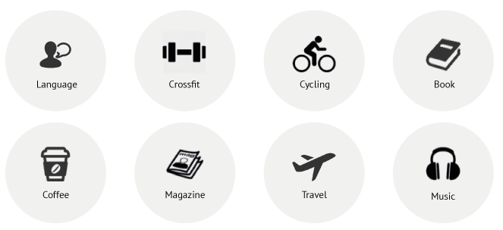
IN THIS PRESENTATION:
About Me
Qualifications/ Education
Skill Sets
Hobbies

Slide 3
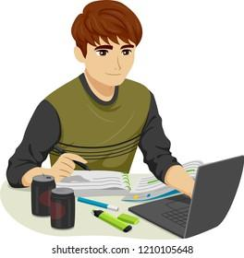
ABOUT ME:
I’m Abdullah Yousuf and I’m a 21 year old male. I’m currently enrolled in IBA (first semester, BBA). Besides, I work as a Store Manager at British Bites, which is a luxury goods retailing office/shop.
I’m very ambitious and enthusiastic about my work. I love what I do and I do not compromise on it.

Slide 4


QUALIFICATIONS/
EDUCATION/ EXPERIENCE
O LEVELS, BEACONHOUSE SCHOOLING SYSTEM
INTERMEDIATE, HAJI ABDULLAH HAROON COLLEGE

Slide 5
PARTICIPATED IN PUBLIC SPEAKING PLATFORMS
WON SPECTRUM IN CEDAR IN 2019
WORKED AT A CALL CENTRE
WORKED AS A SALESMAN

Slide 6

If I have to describe myself in two simple words, that’d be:
Multi-tasking, I tend to keep a balance between my academics, work and personal life.
Hardworking, I believe that hard work always pays off. And this keeps me motivated.

Slide 7

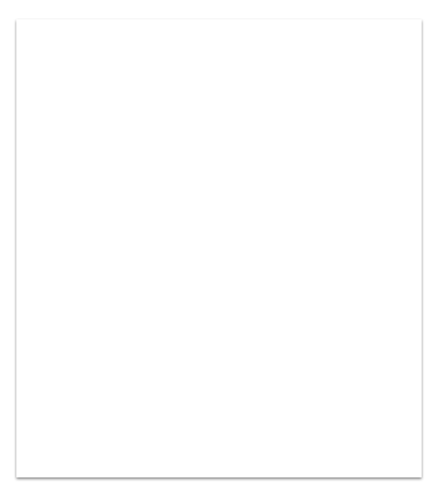
SKILLS:
Interpersonal Relations/ communication
Efficiency
Multitasking
Creativity
Dedication

Slide 8
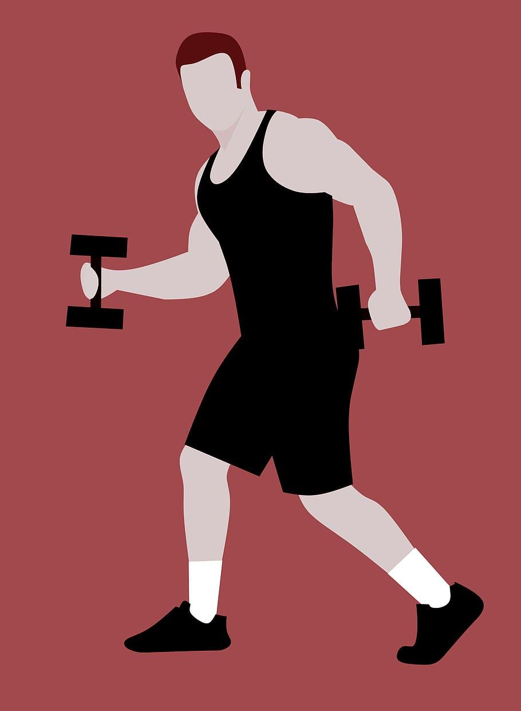
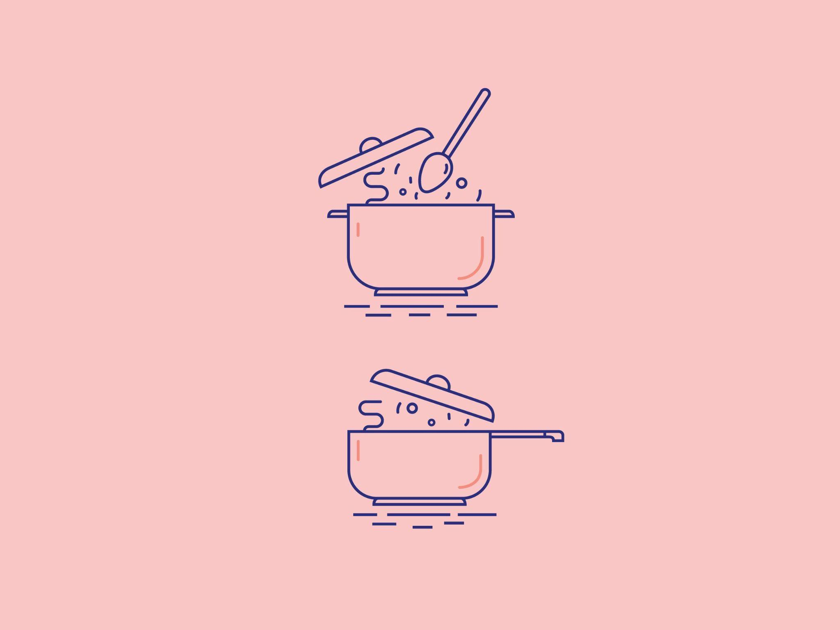
HOBBIES:
GYMMING! Yes! I love gymming or to be precise, I love any sort of physical activity that involves every inch of my body.
Cooking, well, it’s more of a mood thing but I really do love to cook for the people I love. Things like… making my girlfriend/ future wife a breakfast in bed.

Slide 9
This was all about myself.
THANK YOU!

